Slide 1
LECTURE: 3
Search Strategies

Slide 2
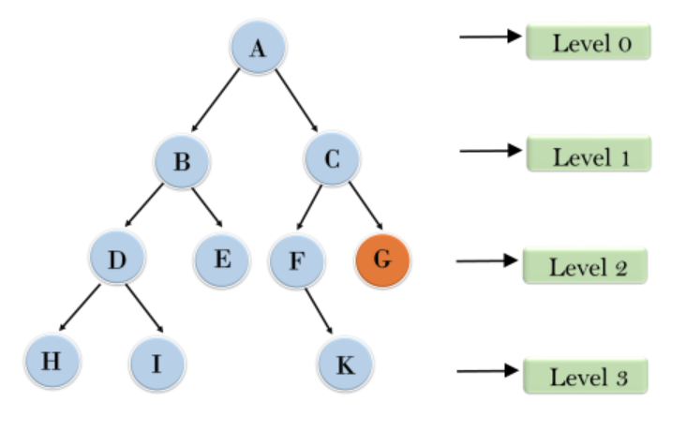
Iterative Deepening Search (IDS)
Combines DFS and BFS features.
Repeated DFS with increasing depth limits.
Suitable for memory-constrained problems
Time complexity: O(b^{d})
Space complexity: O(bd)
Eg: Puzzle Solving, Game AI, Robotics

Slide 3
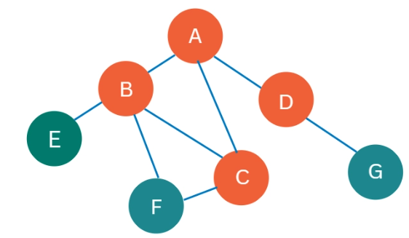
Algorithm of Iterative Deepening Search (IDS)
Set initial depth limit to zero.
Perform Depth-Limited Search (DLS).
Increment depth limit after each iteration.
Continue DLS within updated depth limit.
Check if goal node is found.
Repeat until goal found or limit reached.

Slide 4
Advantages of IDS:
Memory efficient like Depth-First Search.
Guarantees finding the optimal solution.
Avoids getting stuck in infinite loops.
Combines benefits of DFS and BFS.
Suitable for deep, unknown search spaces.
Expands shallow nodes multiple times effectively.

Slide 5
Disadvantages of IDS:
Repeated work in re-expanding nodes.
Slower than BFS for shallow solutions.
Higher computational cost due to repetition.
Not ideal for high branching factors.
Inefficient for problems with uniform costs.
Requires goal state to be predefined.

Slide 6
Advantages of Uninformed Search Strategies:
Simple and easy to implement.
Requires no prior domain knowledge.
Guarantees finding a solution, if exists.
Suitable for small search spaces.
Systematic exploration of all possibilities.
Can be applied to diverse problems.

Slide 7
Disadvantages of Uninformed Search Strategies:
Inefficient for large search spaces.
High time and memory requirements.
Lacks optimization for best solutions.
Explores irrelevant or redundant paths.
Cannot handle infinite search spaces.
Fails in complex or dynamic problems.

Slide 8
Quiz Time
Which search strategy may loop infinitely?
    a) Breadth-First Search
    b) Depth-First Search
    c) Uniform Cost Search
    d) Iterative Deepening Search

Slide 9
Quiz Time
Which is NOT an uninformed search?
    a) Breadth-First Search
    b) Depth-First Search
    c) Uniform Cost Search
    d) A* Search

Slide 10
NEXT: Explore Informed Search Strategies

